Slide 1

Family Partners
A program created with families at the core

Slide 2
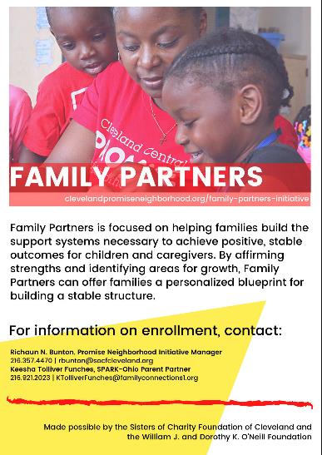

Slide 3
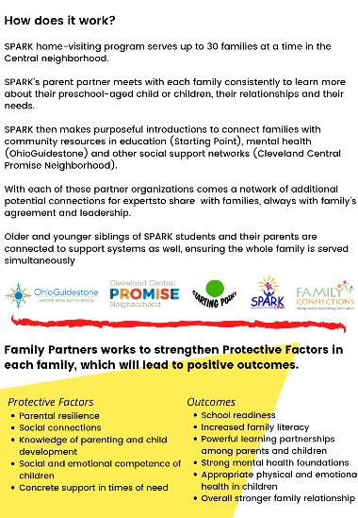

Slide 4


































•
•
•
•

Slide 5

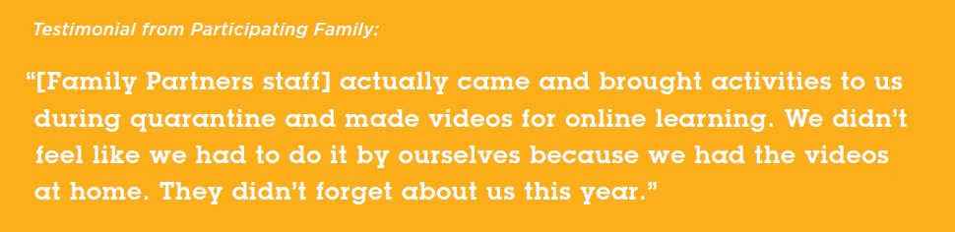
FAMILY
PARTNERS
Family Partners is focused on helping families build the support systems necessary to achieve positive, stable outcomes for children and caregivers. By affirming strengths and identifying areas for growth, Family Partners can offer families a personalized blueprint for building a stable structure.
FIRST COHORT: 2020
27 families completed Year 1 (90% retention) 23.8% learning gain in early numeracy in children
Majority of children on-track in developmental milestones Increase family literacy
Increased interest in supporting child literacy
Peer-to-peer family support through virtual social groups Increased family understanding of age-appropriate activities
Increased in amount of books read to child
Increased skills related to teaching their child, showing affection, responsiveness, and encouragement
SECOND COHORT: 2021
Current co-hort of 27 families.
14 individuals are currently engaging in Mental Health support provided by Ohio Guidestone partner.
Have established new partnerships with Bright Beginnings & Dolly Parton Imagination Library (Literacy Cooperative)
77.5%
learning gain in parents/caregivers of skills to teach children - 2020
70.8%
learning gain in pre-literacy in child participants - 2020

Slide 6

COVID RESPONSE
In finding new ways to communicate amid stay-at-home orders, we began producing videos highlighting the work of partners in the community to support families and residents to cope with the many changes.

Slide 7

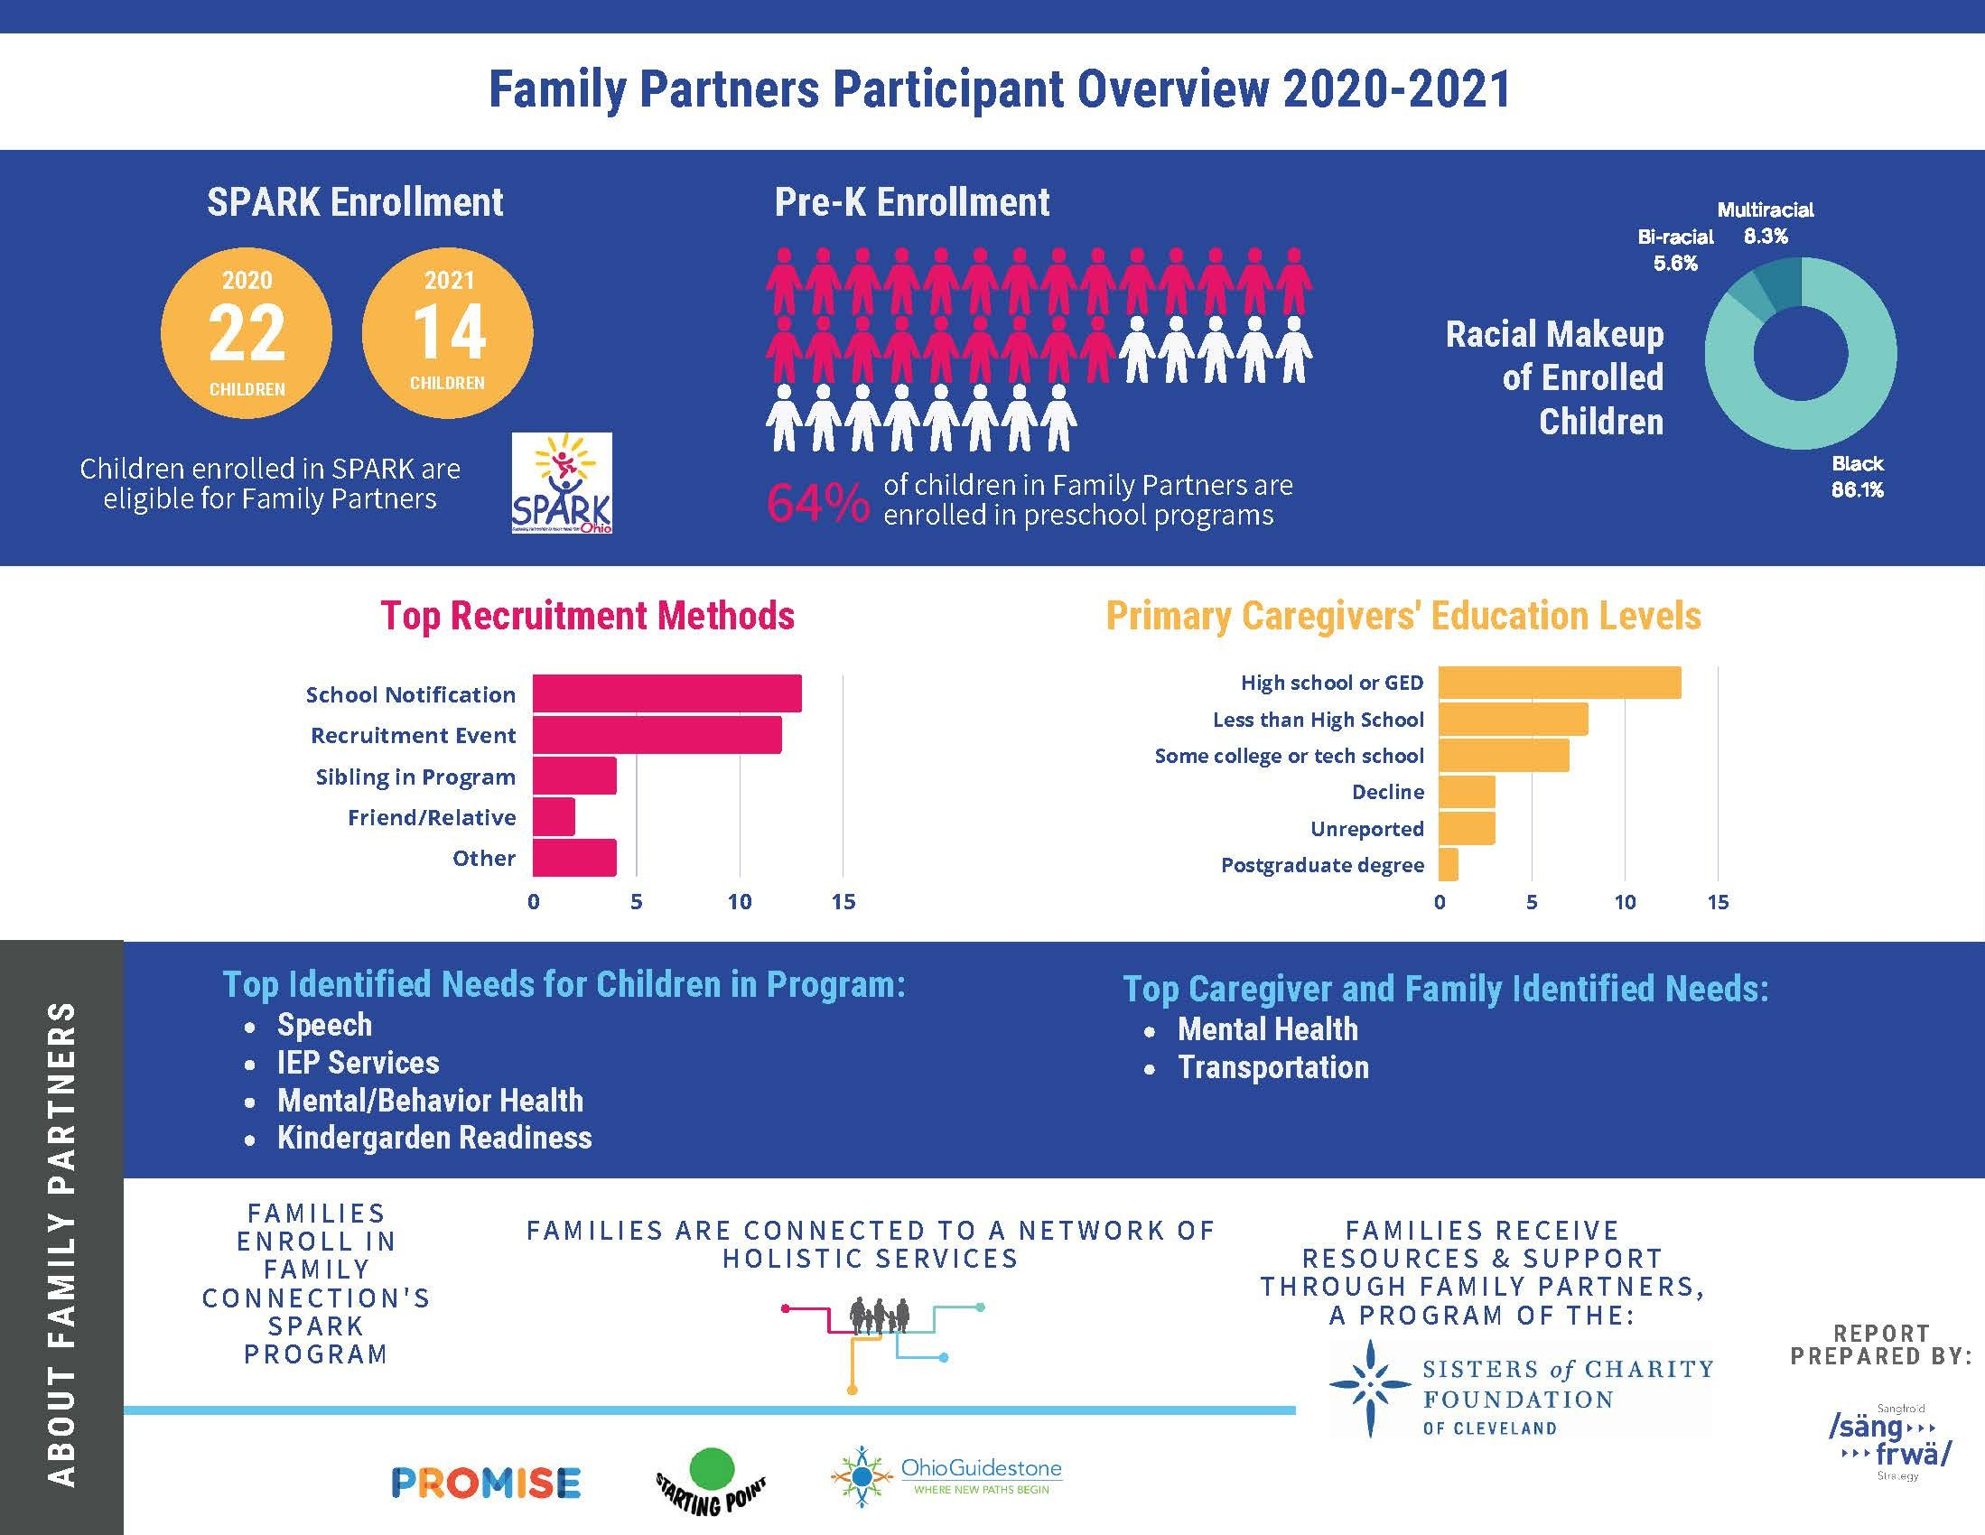
Parent Advisory Council
Meeting cadence established; first meeting held in January 2021
Virtual social connection opportunities continue.
Parents are leading and initiating conversations.
Parents are taking the lead on peer-to- peer dialogue
Serving as breakout room hosts in the virtual parent cafés lead by Family Connections -SPARK Ohio.

Slide 8

The Impact of the 2Gen approach
Our partnership honors the lived experiences of families
Our partnership seeks to streamline supports families identify as a need without exasperating trauma
Our partnership promotes a team-based approach to supporting families in attaining their chosen family goals.

